Slide 1

Auto-Pricing Intelligence
Mentor : Jainesh Garg
Group 4 | Adithya | Ajai | Hassain | Rohith | Vignesh

Slide 2
AGENDA
INTRODUCTION
EDA
TREATING OUTLINERS
SCALING THE DATA
MODEL BUILDING
MODEL COMPARISION
BUSINESS RECOMMENDATION

Slide 3
INTRODUCTION
Buying a used car presents both excitement and financial benefits. Machine learning has simplified this process by predicting prices based on critical factors like a car's age, mileage, and horsepower.
In today's automotive landscape, used cars often offer remarkable value, given their durability and longevity. Predicting the price of a used car is a multifaceted task, as it hinges on a multitude of variables.
However, not all information about these factors is readily available to buyers. Despite this challenge, we've narrowed down the essential criteria to assist buyers in their decision-making process. With this approach, we aim to help families on a budget save money and make well-informed choices when purchasing pre-owned cars.

Slide 4
PROBLEM
The objective is to provide buyers, sellers, and dealers with an easy-to-use tool for estimating the value of a used car, which can facilitate fair and efficient transactions in the used car market.
In challenging economic circumstances, there's a probable uptick in the sales of both imported reconditioned vehicles and used cars. Providing customers with more comprehensive pricing, based on a broader range of attributes, will be advantageous. This approach equips buyers with enhanced insights into an improved pricing model.
Collect and analyse a large dataset of historical used car sales data to train the predictive model.
The core problem statement for this project is to develop a predictive model for used car data that accurately estimates the fair market value of a particular used car based on historical sales data and various relevant factors such as age, mileage, make and model, and condition

Slide 5
APPROACH
Our objective is to calculate the profit earned by a car seller based on depreciation, you would first need to estimate the original price of the car when it was new. This can be done by using the selling price of the car and the known depreciation rate per year for the car's make and model.
We have planned to conduct exploratory data analysis, assess correlations, and subsequently construct various models to determine the best fit for the dataset.

Slide 6
DATASET INFORMATION
Columns | Description
id | Unique identification number
region | Region where the car is located
price | Selling price of the car (local currency)
months Old | Age of the Car from which the product is manufactured.
manufacturer | The brand of the car, such as Toyota, Honda, Ford, etc.
condition | The overall condition of the car, such as excellent, good, fair, or poor.
No of owners | The number of owners pertaining to a car.
fuel | The type of fuel the car runs on, such as gasoline, diesel, or electric.
odometer | The total distance the car has been driven (measured in miles or kilometers).
original Price | Actual Price of a car.
transmission | The type of transmission, such as automatic or manual.
lat | Latitude of the car's location
long | Longitude of the car's location
Shape of the data
Rows | Columns
404026 | 18

Slide 7
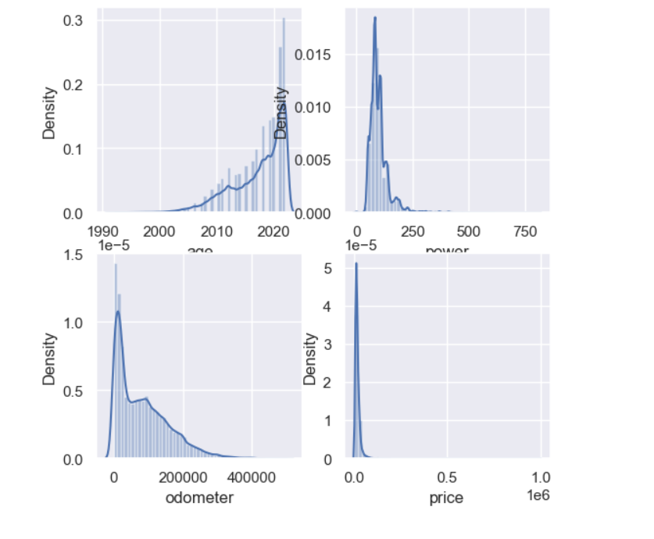

'age' Distribution Plot : -This plot likely shows the distribution of the 'age' variable, which may represent the age of cars(e.g., vehicles, people, etc.).
'power' Distribution Plot : - This plot likely displays the distribution of the 'power' variable, which could represent the power of something (e.g., engine power in vehicles).
'odometer' Distribution Plot : - This plot is likely illustrating the distribution of the 'odometer' variable, which might represent the mileage or usage of something (e.g., vehicles).
'price' Distribution Plot : - This plot probably shows the distribution of the 'price' variable, which could represent the prices of something (e.g., products, vehicles, etc.).
EDA
Distribution Plot

Slide 8

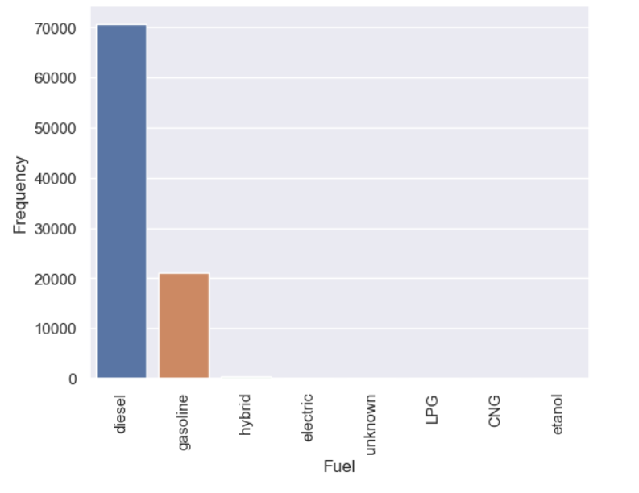
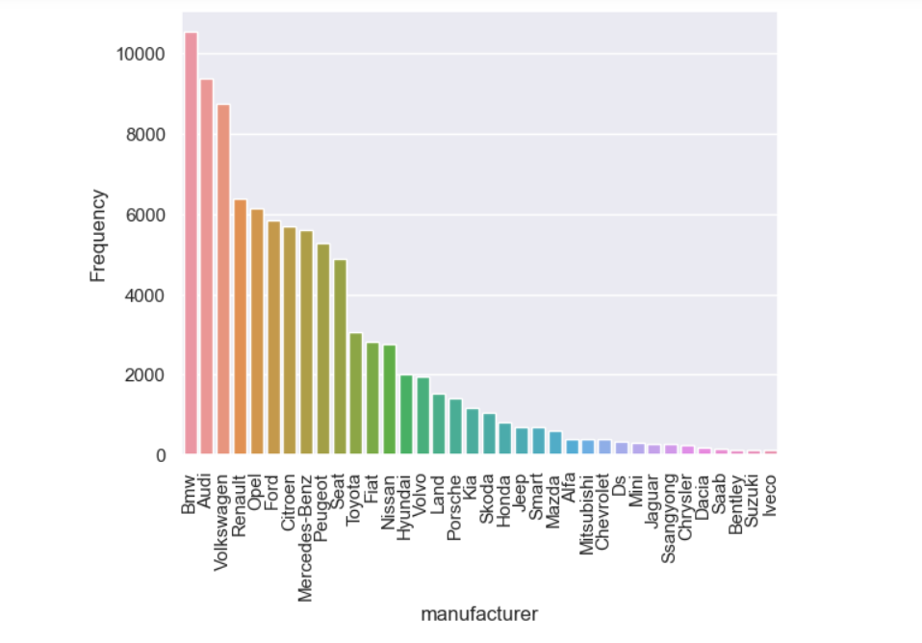
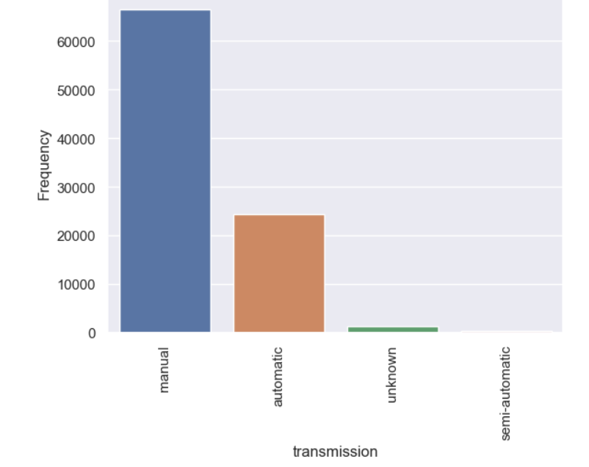
Frequency Plots - Frequency of the different categorical variables to get a better understanding of their distribution and potentially drop some variables that may act as outliers.

Slide 9
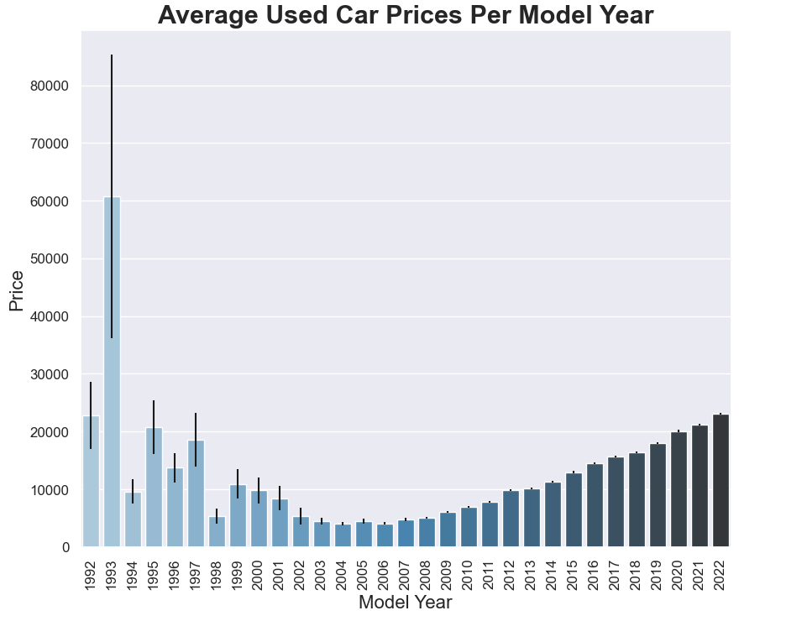
Visualization
1. Trend in Average Prices: By looking at the heights of the bars, you can discern the average prices of used cars for different model years.
2. Variability in Prices: The error bars (represented by `year`) provide information about the variability or uncertainty in the average prices.
3. Model Year Influence: You can see which model years tend to have higher or lower average prices.
4. Visual Appeal: The plot is aesthetically pleasing, with a clear title, properly labeled axes, and rotated x-axis labels for readability.
Notes:
1. **Trend in Average Prices**: By looking at the heights of the bars, you can discern the average prices of used cars for different model years. It allows you to identify whether there's a general trend of increasing or decreasing prices over the years. This can be useful for understanding the depreciation of cars over time.
2. **Variability in Prices**: The error bars (represented by `yerr`) provide information about the variability or uncertainty in the average prices. A wider error bar indicates more variation in prices for that particular model year. This helps in assessing the stability of prices over the years.
3. **Model Year Influence**: You can see which model years tend to have higher or lower average prices. This information can be valuable for car buyers and sellers, as it reflects the desirability and market value of cars from different years.
4. **Visual Appeal**: The plot is aesthetically pleasing, with a clear title, properly labeled axes, and rotated x-axis labels for readability. It's well-formatted for presentation and communication of insights.
5. **Data Export**: The code saves the plot as an image file (pricect.png) at a high resolution (DPI=400), which makes it suitable for use in reports, presentations, or publications.

Slide 10
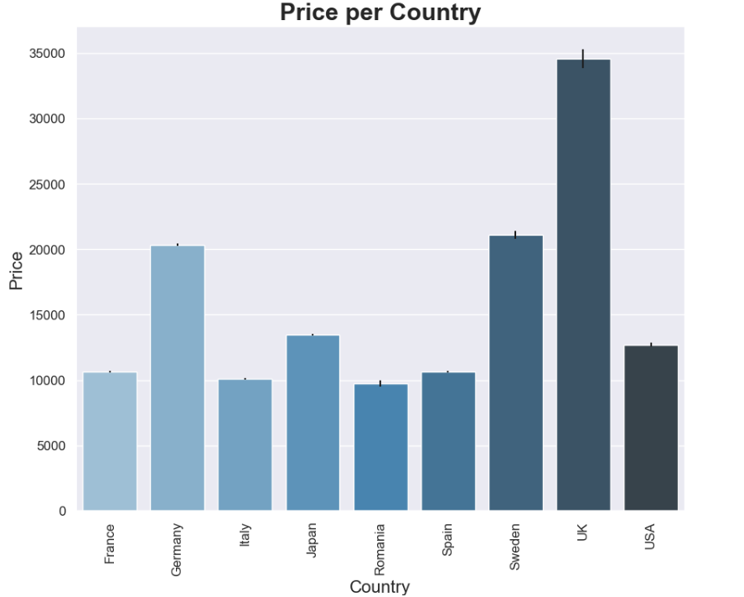
Visualisation of price based on Country
1. Average Prices by Country: The bar chart displays the average price of items for different countries.
2. Uncertainty in Average Prices: The error bars, calculated as the standard error of the mean (SEM), indicate the variability or uncertainty in the average prices for each country.
3. Visual Clarity: The plot is well-structured with a clear title, properly labeled axes, and rotated x-axis labels for improved readability.
4. Data Analysis: This type of plot is useful for assessing how prices of items vary across different countries.
5. Decision Support: The insights gained from this plot can inform decisions related to pricing, marketing, or product distribution strategies in various countries.
Notes:
1. **Average Prices by Country**: The bar chart displays the average price of items for different countries. Each bar represents a specific country, and the height of the bar corresponds to the average price. This allows you to compare the average prices across countries.
2. **Uncertainty in Average Prices**: The error bars, calculated as the standard error of the mean (SEM), indicate the variability or uncertainty in the average prices for each country. Larger error bars suggest greater variability, while smaller error bars suggest more confidence in the calculated mean.
3. **Visual Clarity**: The plot is well-structured with a clear title, properly labeled axes, and rotated x-axis labels for improved readability. The color palette ("Blues_d") enhances the visual appeal of the plot.
4. **Data Analysis**: This type of plot is useful for assessing how prices of items vary across different countries. It can be helpful in identifying countries where items tend to be more expensive or cheaper on average.
5. **Decision Support**: The insights gained from this plot can inform decisions related to pricing, marketing, or product distribution strategies in various countries.

Slide 11
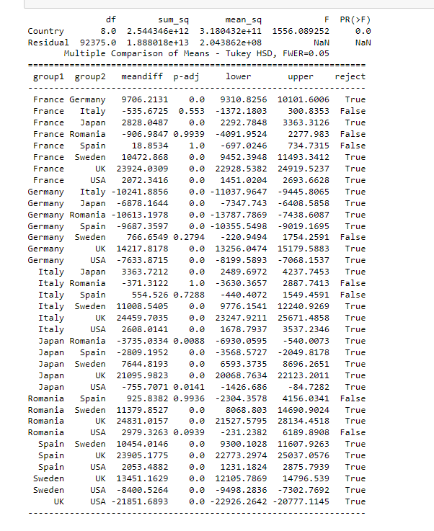
ANOVA
One-way ANOVA (Analysis of Variance)
ANOVA Results
Tukey's Honestly Significant Difference (HSD)
In summary, Anova allows you to statistically assess and understand whether there are significant differences in the 'price' of items across different countries and provides information about which specific country pairs have significantly different average prices.
This analysis is valuable for making informed decisions related to pricing and market strategies in different regions.
Notes:
In summary, the code allows you to statistically assess and understand whether there are significant differences in the 'price' of items across different countries and provides information about which specific country pairs have significantly different average prices. This analysis is valuable for making informed decisions related to pricing and market strategies in different regions.

Slide 12
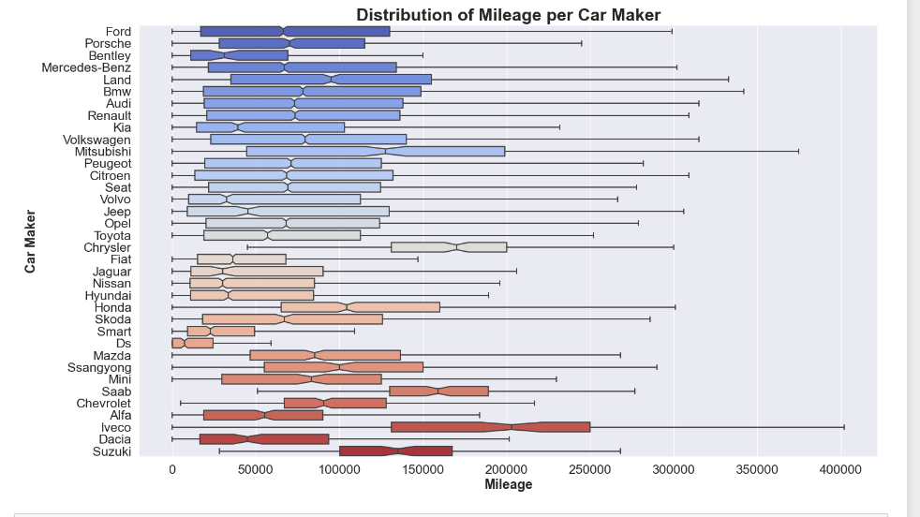
Distribution of Price per Country
Mileage Distribution: The boxplot presents the distribution of mileage for various car manufacturers. Each horizontal box represents a different car maker, and the length of the box corresponds to the interquartile range (IQR), which indicates where most of the data lies.
Outlier Display: The parameter `showfliers=False` is used, which means that outliers (values far from the median) are not displayed on the plot. This can provide a clearer view of the central tendency of mileage for each manufacturer.
Visual Clarity: The plot is visually appealing and well-structured. It includes clear labels for the x and y-axes, a title for easy interpretation, and a custom color palette ("coolwarm") that enhances the visual appeal of the plot.
Comparison between Car Makers: This plot allows you to compare the mileage distribution between different car manufacturers. You can identify which manufacturers tend to have higher or lower mileage on average.
Data Analysis: By examining this plot, you can gain insights into the mileage characteristics of various car makers, which can be valuable for making informed decisions related to the purchase, sale, or marketing of vehicles.

Slide 13
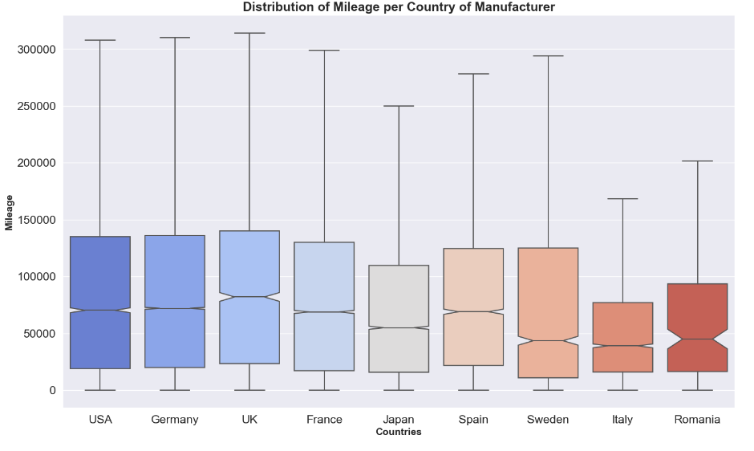
Distribution of Price per
Country OF Manufacturer
Mileage Distribution: The boxplot presents the distribution of mileage for various countries where manufacturers are located. Each box represents a different country, and the length of the box corresponds to the interquartile range (IQR), indicating where most of the data lies.
Outlier Display: The parameter `showfliers=False` is used, which means that outliers (values far from the median) are not displayed on the plot.
Comparison between Countries: This plot allows you to compare the mileage distribution between different countries where manufacturers are located.
Data Analysis: By examining this plot, you can gain insights into the mileage characteristics of vehicles from different countries, which can be valuable for assessing the manufacturing quality and potential differences in driving conditions across countries.

Slide 14
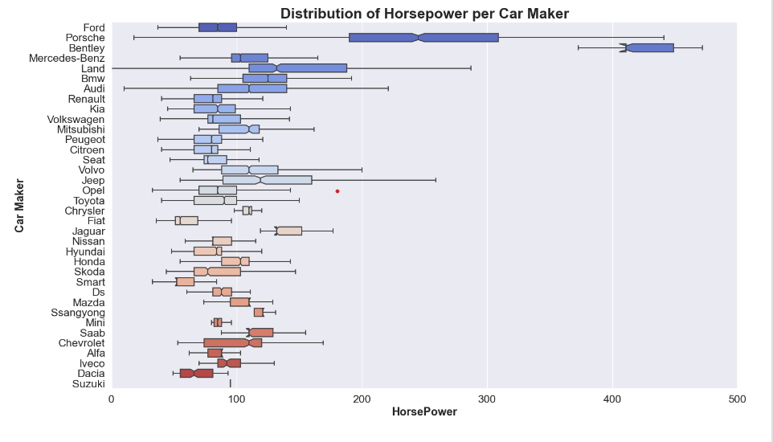
Distribution of Horsepower PER CAR MAKER
Horsepower Distribution: The boxplot presents the distribution of horsepower for various car manufacturers.
Outlier Display: The parameter `showfliers=False` is used, which means that outliers (values far from the median) are not displayed on the plot.
Comparison between Car Makers: This plot allows you to compare the horsepower distribution between different car manufacturers.
Data Analysis: By examining this plot, you can gain insights into the horsepower characteristics of various car makers, which can be valuable for assessing the performance and power of vehicles from different manufacturers.
Custom Range: The x-axis range is limited to 0 to 500, which narrows the focus of the plot and makes it easier to compare and analyze the data within that range.

Slide 15
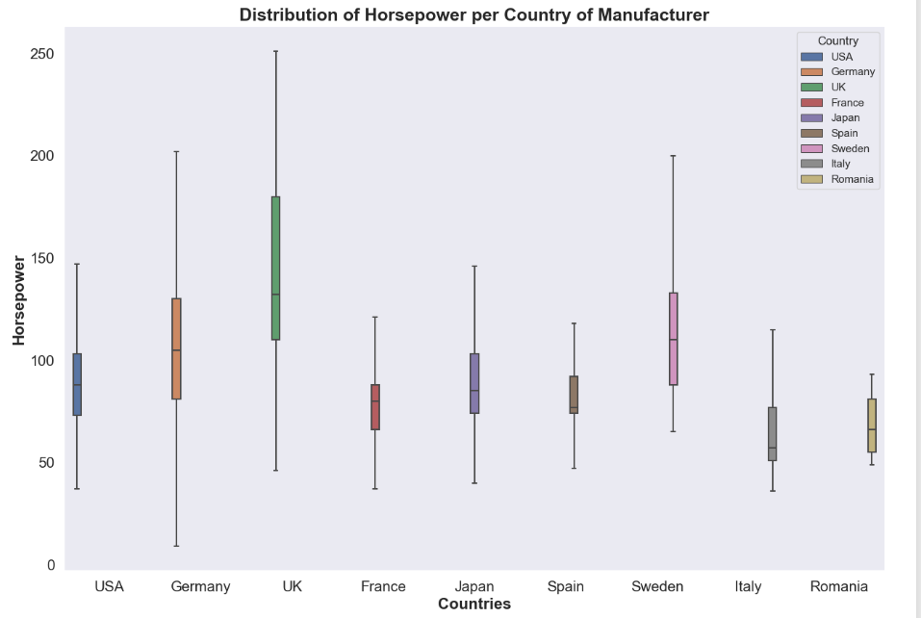
Distribution of Horsepower PER Country of Manufacturer
Horsepower Distribution: The boxplot displays the distribution of horsepower for vehicles manufactured in various countries. Each box represents a different country, and the length of the box corresponds to the interquartile range (IQR), indicating where most of the data lies.
Outlier Handling: The parameter `showfliers=False` is used, which means that outliers (values far from the median) are not displayed on the plot. This can provide a clearer view of the central tendency of horsepower for each country.
Hue for Country: The 'hue' parameter is used to differentiate the boxes by country. This allows for easy comparison of horsepower distributions among different countries in a single plot..
Data Analysis: This plot helps you gain insights into the horsepower characteristics of vehicles from different countries. It allows for a comparison of performance attributes based on manufacturing location.
Notes:
1. **Mileage Distribution**: The boxplot presents the distribution of mileage for various car manufacturers. Each horizontal box represents a different car maker, and the length of the box corresponds to the interquartile range (IQR), which indicates where most of the data lies.
2. **Outlier Display**: The parameter `showfliers=False` is used, which means that outliers (values far from the median) are not displayed on the plot. This can provide a clearer view of the central tendency of mileage for each manufacturer.
3. **Visual Clarity**: The plot is visually appealing and well-structured. It includes clear labels for the x and y-axes, a title for easy interpretation, and a custom color palette ("coolwarm") that enhances the visual appeal of the plot.
4. **Comparison between Car Makers**: This plot allows you to compare the mileage distribution between different car manufacturers. You can identify which manufacturers tend to have higher or lower mileage on average.
5. **Data Analysis**: By examining this plot, you can gain insights into the mileage characteristics of various car makers, which can be valuable for making informed decisions related to the purchase, sale, or marketing of vehicles.
6. **Data Export**: The code saves the plot as an image file named 'mileagect.png', making it suitable for inclusion in reports, presentations, or publications.

Slide 16


Frequently USED CAR in
THE DATASET (Let’s Find it)

Slide 17
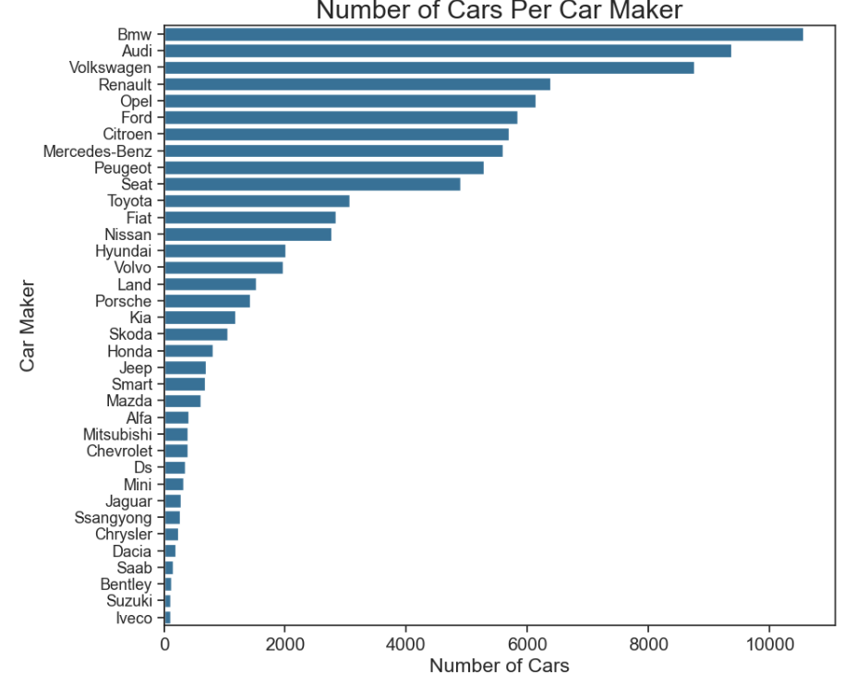
NO OF CARS BASED ON BRAND
Number of Cars per Manufacturer: The horizontal bar plot displays the number of cars produced by each car maker.
Visual Style: The code employs a specific visual style by using `sns.set_style("ticks")` and customizing the tick sizes for better visual appeal.
Data Aggregation: The code first calculates the number of cars for each manufacturer and sorts them in descending order to visualize the manufacturers with the most cars at the top.
Data Analysis: This plot helps you understand which car makers have the highest and lowest production levels, providing insights into the market share and presence of each manufacturer in your dataset.
Notes:
BMW is the brand which produces more number of cars around 10000.
followed by the brands Audi,Volkswagen and Renault
The least produced car is Lveco which has less than 500 cars

Slide 18
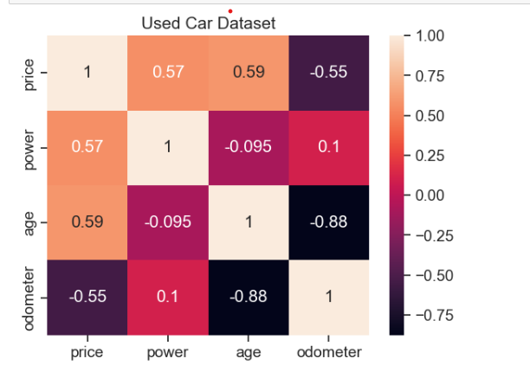
HEAT MAP (WITH THIS THE EDA ENDS.. PHEWWW!!)

Slide 19
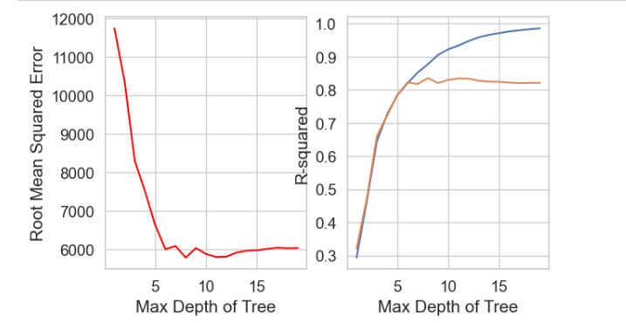
ML MODELS
DECISION TREE MAKER

Slide 20
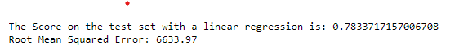

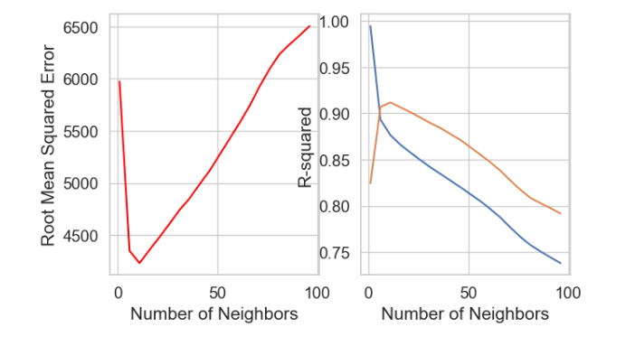
ML MODELS
Linear Regression Model
KNN Regressor

Slide 21



ML MODELS
Random Forest
XgBoost Regressor

Slide 22





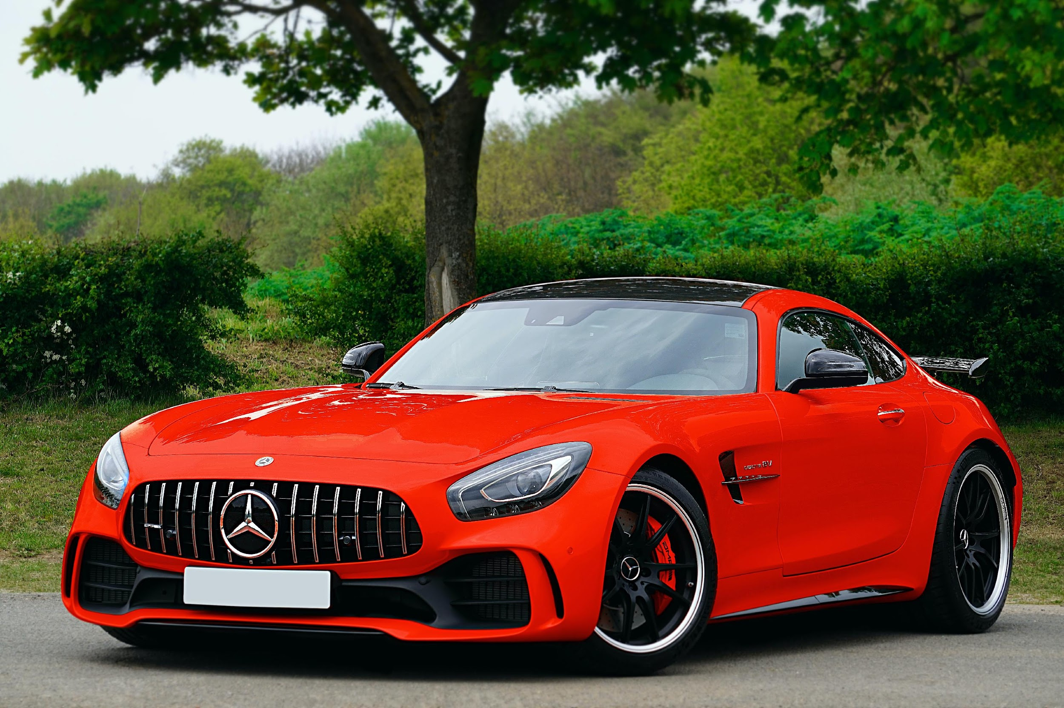
Summary of ML Models:
Linear Regression Model
We have pre processed the data, build a linear regression model, made predictions, and evaluate its performance. The key goal is to understand how well the model can predict target values based on the features.
KNN Regressor
This took a significant execution time delays because it involves a loop that traverses a range of n_neighbors values in a KNeighborsRegressor model, calculating different scores and root mean squared errors. Specifically, it used a range defined as np.arange(1, 100, 5), which implies that the loop covered values from 1 to 99, incrementing by 5 at each step.
XgBoost Regressor
We hace used this model on training data. After training the model, it's using the test data (X_test) to make predictions, and then it's evaluating the model's performance.

Slide 23
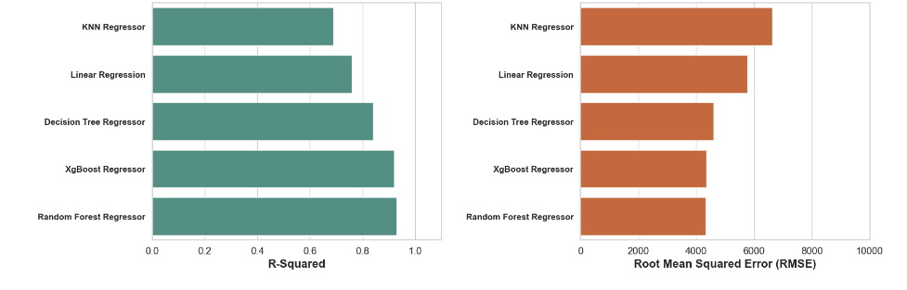
MODELS
COMPARISON

Slide 24
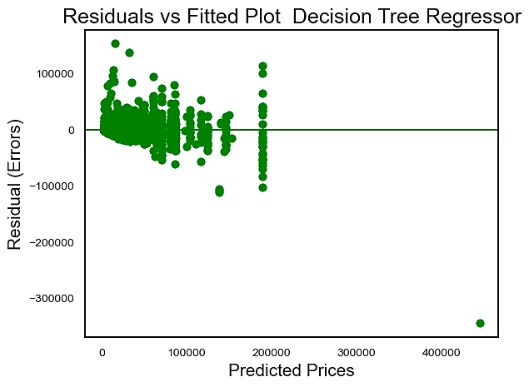
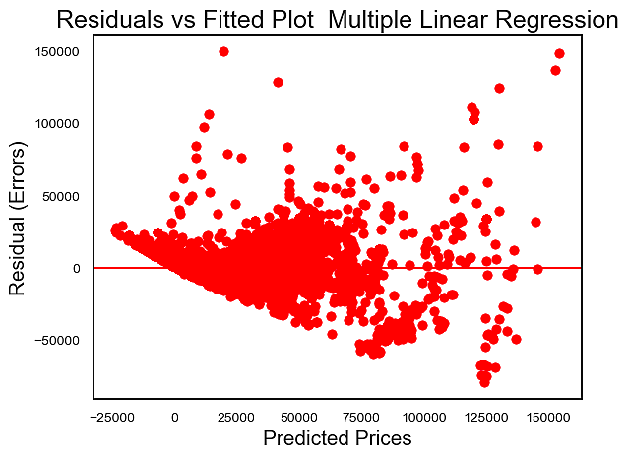
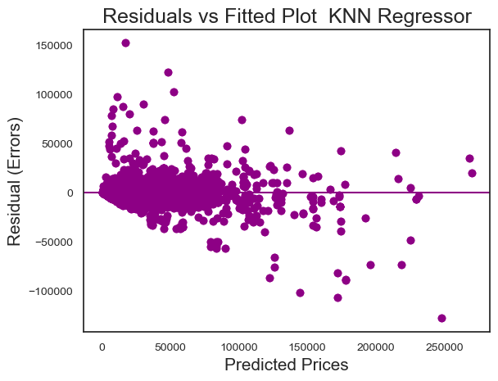
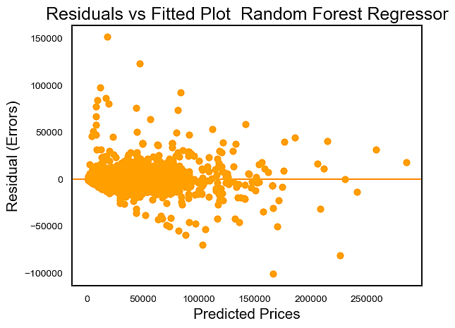
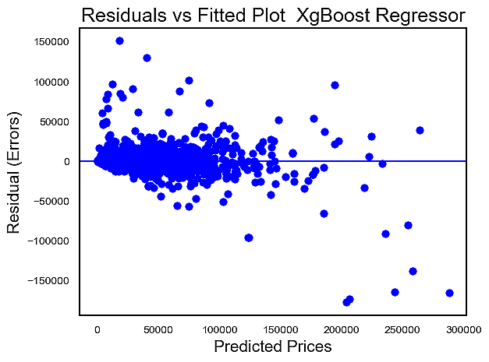
RESUDIAL PLOTS

Slide 25
PLOTS Summary:
The Random Forest Regressor with hyperparameter optimization appears to have performed the best. It has a high R-squared score on both the training and test sets, indicating good explanatory power and generalization capability. The MSE is also relatively low, suggesting accurate predictions.
The KNN Regressor also performed well, with a high R-squared score on the test set and a low MSE.
The Decision Tree Regressor performed decently but had a slightly lower R-squared score on the test set compared to the other models, and a higher MSE.
The Linear Regression model had the lowest R-squared score on the test set and the highest RMSE, indicating that it may not fit the data as well as the other models.
The XGBoost Regressor performed well but had a slightly lower R-squared score and a higher MSE compared to the Random Forest and KNN models.
HENCE:
The Random Forest Regressor with hyperparameter optimization would be a strong candidate.

Slide 26
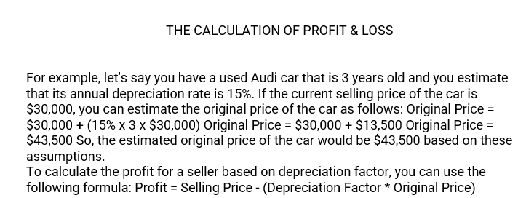
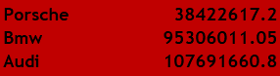
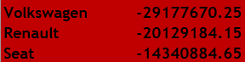
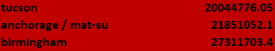
We found that the top three manufacturers of selling a car are the below:
We found that the top three manufacturers who do not make a good profit
The below has the highest profits.

Slide 27
Summary of the Profit & Loss:
We recommend considering the purchase or emphasis on used cars from the three manufacturers: Porsche, BMW, and Audi. These manufacturers have consistently demonstrated the ability to yield some of the highest resale values and profits among others.
We advise against purchasing or prioritizing used cars from the three manufacturers: Volkswagen, Renault, and Seat. These brands typically offer lower resale values, resulting in reduced or no profit when compared to other manufacturers in the market
We recommend purchasing or directing your focus toward used cars from the following models: Tucson, Mat-su, and Birmingham, as they not only yield the highest profits but are also the top-selling models among the manufacturers.

Slide 28

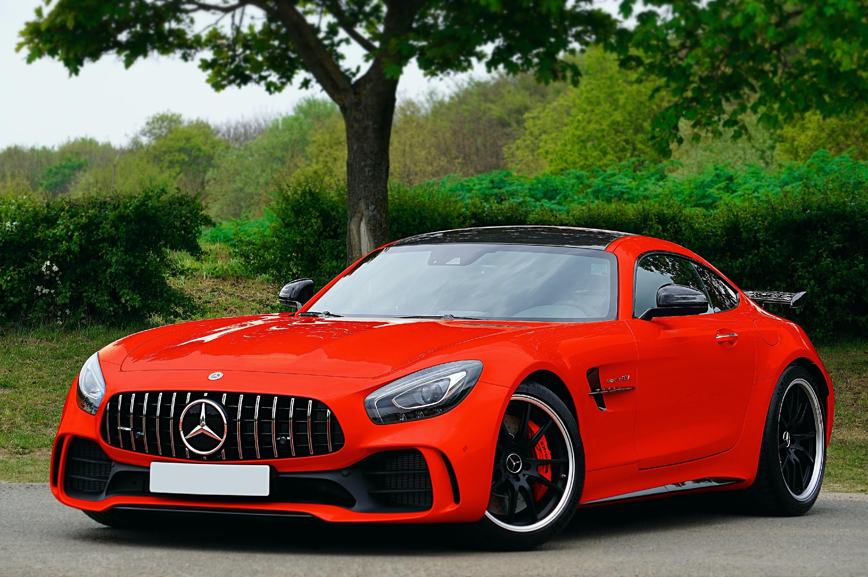





RECOMMENDATIONS
Our used car pricing model is designed to assist used car sellers in ensuring they receive fair compensation for their pre-owned vehicles.
While our model currently provides accurate predictions and value analysis for used cars, there is still a margin of error. Minimizing this error is a top priority.
We also aim to reduce the time required for the development of a precise random forest regression model. These enhancements will lead to an immediate and significant impact on our business.
- Increasing the availability of "low mileage" cars.
- Expanding the inventory of vehicles with "automatic transmissions.
- Adding more "diesel" cars to our listings.
With Increasing petrol rates diesel car are in more demand in recent years, acquiring and selling them can high profits
We can provide Car maintenance packages where customers pay a small upfront fee and can bring the car for servicing anytime in a year to attract more customers.
The next step post that would be to cluster different sets of data and see if we should make multiple models for different locations/car types.
Kilometres Driven have a negative relationship with the price which is intuitive.
. A car that has been driven more will have more wear and tear and hence sell at a lower price, everything else being 0.
The categorical variables are a little hard to interpret
But it can be seen that all the car category variables in the dataset have a negative relationship with the Price and the magnitude of this negative relationship decrease as the brand category moves to lower brands.

Slide 29
Thank you….. Group 4 saying a bye.. :p

